Slide 1
DEPARTMENT OF MECHANICAL MINOR PROJECT-3
Final Review
LOADING AND UNLOADING MECHANISM USING MOTORIZED SYSTEM
TEAM MEMBERS:
KABINESH G
KANISHKAR K
KARAN S
GUIDED BY:
Dr M MOHANPRASAD M.E, MBA,Ph.D
ASSOCIATE PROFESSOR
HEAD OF MECHANICAL DEPARTMENT

Slide 2
ABSTRACT
The Loading and Unloading Mechanism Using a Motorized System is an automated solution designed to streamline the movement of goods, materials, or products in industrial settings, such as warehouses, manufacturing facilities, and logistics centers. This system uses a motorized conveyor, electric motors, sensors, and optional robotic arms to efficiently transfer items between storage areas, production lines, or transport vehicles. By automating the loading and unloading processes, this system enhances productivity, improves safety, and reduces handling times. This innovative approach offers a cost-effective, efficient, and safe method for handling materials, making it an essential component for modern automated systems in material handling.

Slide 3
INTRODUCTION
A motorized loading and unloading system uses key components such as motorized conveyors, electric motors, sensors, and, in some cases, robotic arms to facilitate seamless and accurate movement of items. These systems can be tailored to various load types, making them versatile solutions suitable for industries like manufacturing, logistics, and agriculture
A motorized loading and unloading mechanism is an automated system that utilizes electric motors to efficiently move and transfer materials onto or off a designated platform, significantly reducing manual labor and enhancing productivity by providing a controlled and precise method for handling goods, particularly in industrial settings where repetitive loading and unloading tasks are common.

Slide 4
WORKING
A motorized loading and unloading mechanism typically uses electric motors to power a mechanical system, like a conveyor belt, robotic arm, or linear actuator, to automatically move items onto and off a designated platform or machine, significantly reducing manual labor and improving efficiency in various industrial processes.

Slide 5
COMPONENTS USED
CONVEYOR BELT
ELECTRIC MOTOR
ROBOT ARM
LIFTING MECHANISM
FRAME

Slide 6
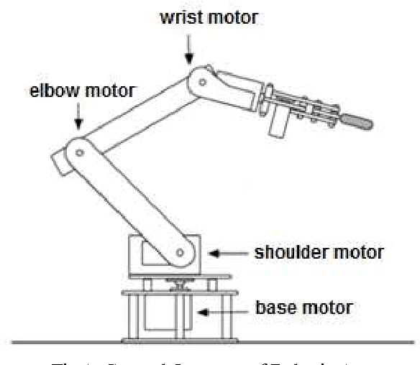
DIAGRAM

Slide 7
ADVANTAGES
Increased Efficiency
Reduced Labour Cost
Enhance Safety
Good Accuracy
Cost Effectiveness

Slide 8
CONCLUSION
This automation also improves workplace safety by reducing physical strain and minimizing the risk of accidents. With its adaptability and cost-effectiveness, the motorized system is suited for a range of applications, from warehouses and manufacturing facilities to logistics centers and agricultural environments. Overall, the motorized loading and unloading mechanism represents a valuable investment for companies looking to improve productivity, reduce labor costs, and achieve more consistent, reliable performance in their operations.

Slide 9


